Slide 1
Module 3 - Acquisition Strategy
Presented by: [Facilitator Name]
Date: [Session Date]
Notes:
Speaker Notes: Welcome to Module 3. In this module, you will be introduced to the key concepts of how to create an acquisition strategy and a solicitation.

Slide 2
Translate your discovery findings into a well-structured solicitation. Create acquisition strategy decisions around tradeoffs, evaluation processes, contract structure, and performance metrics which lead to the development of requirements, solicitation factors, and evaluation criteria that support user-centered outcomes and successful vendor partnerships.
Module 3 Performance Outcome

Slide 3
Explain the purpose and value of acquisition strategy planning in the federal procurement lifecycle
Identify how acquisition strategies vary depending on inherited contracts versus new procurements
Apply key pre-award activities—such as stakeholder engagement and market research—to inform strategic decisions
Describe the lean canvas approach and its role as a living document in agile acquisition environments
Recognize when and how to update the acquisition strategy based on new inputs and evolving conditions
At the conclusion of this module, you will be able to
Notes:
Speaker Notes:
At the conclusion of this module, you will able to:
Explain the purpose and value of acquisition strategy planning in the federal procurement lifecycle
Identify how acquisition strategies vary depending on inherited contracts versus new procurements
Apply key pre-award activities—such as stakeholder engagement and market research—to inform strategic decisions
Describe the lean canvas approach and its role as a living document in agile acquisition environments
Recognize when and how to update the acquisition strategy based on new inputs and evolving conditions

Slide 4
Sprint 1
Developing a Successful Acquisition Strategy

Slide 5
Understanding What You Are Buying
Presented by: [Facilitator Name]
Date: [Session Date]

Slide 6
Welcome back to
DITAP Training!
Digital IT Acquisition Training Professional (DITAP)
Training Program FCN 500 (CA), DITAP Foundations

Slide 7
Analyzing a Need
Users
Agency/Customers
Contracti
Defining Success
Agenda
User stories
Developing Requirements for Digital Services
Advanced Market Research Strategies

Slide 8
Analyzing a Need
Find the right type of digital service solution
From the User’s Perspective to the Customer’s Requirement
Notes:
How do we avoid what happened in the MAP Case Study?

Slide 9
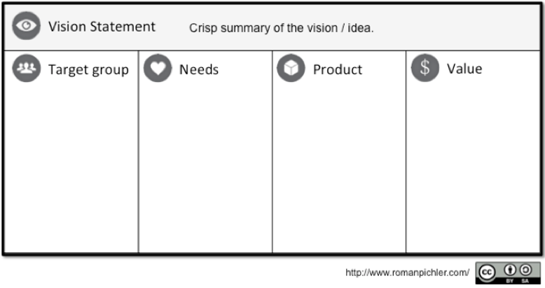
What is a Need?
A product vision can be an appropriate starting place for understanding needs.
Notes:
Speaker Notes: A product vision can be an appropriate starting place for understanding needs.

Slide 10
Key Questions to Define User Needs
What problem are you trying to solve
Who is going to be using the solution?
When will the item be used?
Describe the conditions during which the item will be used
Will the item be part of a larger system?
How will users interact with the item?
How often will users use the item?
What are the key features or attributes of the item?
Notes:
Speaker Notes: These questions are useful when discussing early requirements development with your customers. Doing this exercise is NOT easy - these questions are difficult in reality.
User stories can make this easier.

Slide 11
Understanding User Stories
User stories describe the functions, not the specifications
The basic idea is the gain an understanding of what the user wants to do in order perform or complete a task
Brevity is key; they are traditionally handwritten on index cards to naturally constrain them
Card, conversation, confirmation
Basic syntax
Notes:
Speaker Notes: We ALWAYS write user stories from the customer’s perspective because of the significant value that comes from understanding their needs. I think this is even a good practice for your program customer. While you have to make sure they’re writing these for their underlying requirements, you can ask them to think in this way.
Who are some internal users? CORs, engineers, doctors and nurses, etc. External users are obviously the vets.

Slide 12
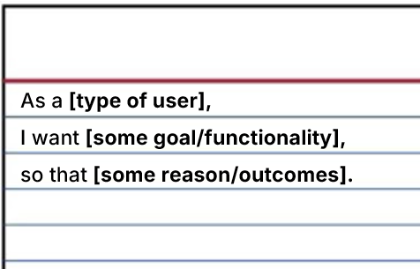
User Story Format
Card
3’x5” index(Excel, Rally)
Limit size to prevent info becoming specs
Conversation
•Understood by every member of the team.
•Explain the what not the how (no tech details).
Confirmation
•Contain Acceptance Criteria(a justification for when dev of story is complete)
Notes:
Speaker Notes: These questions are useful when discussing early requirements development with your customers. Doing this exercise is NOT easy - these questions are difficult in reality.
User stories can make this easier.

Slide 13
User Story Best Practices
ALWAYS write them from the customer’s perspective
Avoid jargon, write them using plain language
Avoid using brand names
Keep in mind the “why” behind a user story can be just as important as the “what”
This is why the conversation process is so important
As a patient, I want to access test results online, so that my caregivers can see them.
Notes:
Speaker Notes:
Independent: can be developed, tested and delivered on its own
Negotiable: not a contract, but a placeholder for discussion
Valuable: must provide value to a user, customer or stakeholder
Estimable: Must be small enough for rapid implementation, contains clear acceptance criteria
Small: sized for a single sprint
Testable: acceptance criteria is verifiable by testers and/or business users

Slide 14
Analyzing a Need
Find the right type of digital service solution
Moving from the Need to the Requirement
Notes:
How do we avoid what happened in the MAP Case Study?

Slide 15
User Story = Experience; Requirement = Functionality
User stories are about who, what, and why
Requirements take those user stories and go into specific detail on how the solution will work
During the project design, similar user stories will be organized into features or releases, and then requirements are developed from those stories.
Notes:
Speaker Notes: We ALWAYS write user stories from the customer’s perspective because of the significant value that comes from understanding their needs.

Slide 16
As a patient, I want to access test results online, so that my caregivers can see them.
What permissions does a patient account have/need
What security protocols must be in place to permit access
Are other caregivers able to access the online portal?
Are users able to transfer test results to other services etc.
Notes:
Speaker Notes: Do these requirements help us understand whether a user story is accomplished?

Slide 17
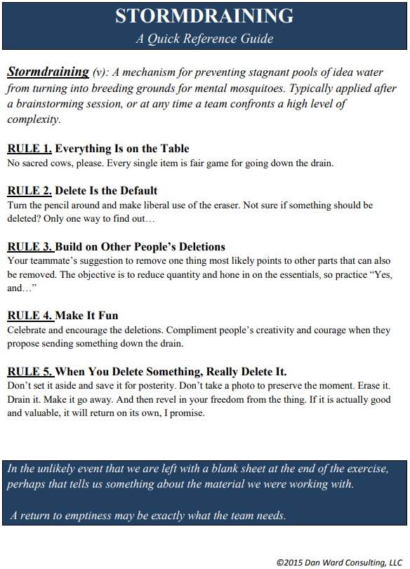
Feeling too crowded? Try some techniques from Dan Ward.
Stormdraining

Slide 18
Defining Success

Slide 19
What Are Acceptance Criteria?
Unique to each user story, they define the outcome from the user’s perspective.
As a patient, I want to access test results online, so that my caregivers can see them.
What are some acceptance criteria for this user story?

Slide 20
Definition of Done
The contractual definition of done includes code review, testing, and deployment.
The technical level definition of done includes: unique set of “acceptance criteria” for a project, or its features, or even all the way down to each individual user story.
What is the Definition of Done?
As a patient, I want to access test results online, so that my caregivers can see them.
Notes:
Speaker Notes: TALK ABOUT DEF OF DONE FROM THE CONTRACT PERSPECTIVE (HIGH-LEVEL) (THE CONTRACTUAL REQUIREMENT) AND THE USER STORY LEVEL (THE TECHNICAL REQUIREMENT)

Slide 21
ACTIVITY: How do you define success?
Notes:
Speaker Notes: Students should do activity worksheet, individually and then in groups

Slide 22
Fulfilling a need via a procurement that delivers a product or service in compliance with all applicable federal regulations (FAR if applicable, etc.), on-time, and under budget.
Compliance-based Success

Slide 23
Fulfilling a need via a procurement that delivers a modern, user-friendly product or service that achieves the ultimate objectives of the requesting program office and continually meets the needs of the user of the product or service
Outcome-based Success

Slide 24
Analyzing a Need
Find the right type of digital service solution
Developing Requirements for Digital Services
Notes:
How do we avoid what happened in the MAP Case Study?

Slide 25
FAR Section 11.002 emphasizes four primary characteristics for writing requirements:
Full & open competition to the maximum extent practicable
Limited use of restrictive provisions
Description in terms of function, performance, and essential physical characteristics
Preference for commercial items
Notes:
Speaker Notes: Guidance on describing agency needs.

Slide 26
FAR 11.101(a) order of precedence:
Documents mandated for use by law
Performance-oriented documents (PWS or SOO)
Detailed designed-oriented documents (SOW)
Standards or specifications issued outside of the Defense of Federal series for non-repetitive items
Notes:
Speaker Notes: Before we can analyze a need, let’s remind ourselves the basics of FAR Part 11, Describing Agency Needs. Which do you think would be best for buying digi services?

Slide 27
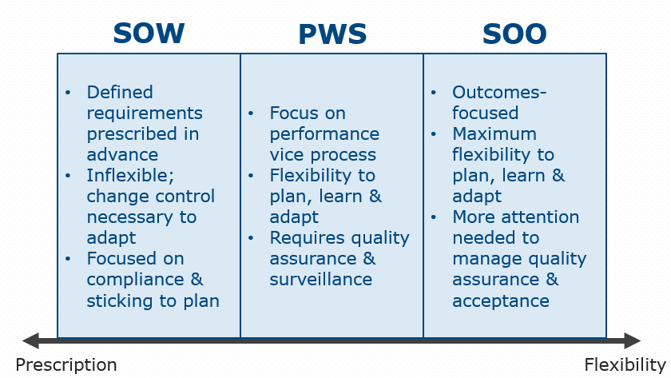
Selecting a Requirements Document
Notes:
Speaker Notes:
SOWs can include acceptance criteria and incorporate performance-based elements. If using, try to include them. Good for well-known tasks that can be specifically described. Here’s a good sample: https://www.gsa.gov/cdnstatic/SOW_Application.Services.and.Component.Framework.pdf
What makes PWS better? Are some requirements docs better than others?
Functional Requirements= does the system do WHAT it is supposed to do?
Performance Requirements= how well does the system do its functions?
Keep in mind the governance and LOE required to administer contracts awarded with these requirements docs.

Slide 28
Key Considerations for Requirements Document
SOW | PWS | SOO
Very lengthy, detailed specifications are expected | Product Vision and (policy driven) tasks | No specifications other than constraints; describe required outcomes
Prescribes technical & schedule requirements w/o measures | Technical & schedule constraints, assumptions are stated in detail | Avoids detailed specs - focuses on results
No performance measurements; seeks compliance | Includes method of performance measurement | Performance measures & metrics are jointly derived
Elicits similar proposal solutions | Elicits a variety of proposal solutions | Elicits maximum number of proposal solutions
Does not include PRS & AQL | Includes PRS & AQL | Includes PRS & AQL
Does not include QAP or QASP | Includes QAP and QASP | Includes QAP and QASP
Notes:
Speaker Notes: How do you know what’s best for your customer? You have to do market research.

Slide 29
Beyond the RFI
Strategies for Better Market Research
Notes:
Speaker Notes: So how can you create outcome based and compliance based requirements? Doing your research. You have to align the users wants with the customers needs and the correct digital solutions. You want to learn what you are buying? Get ready to do the market research.

Slide 30
Thinking outside the RFI box
How do we get the right kind of companies and right people to address digital services needs?
How do we attract non-traditional vendors who haven’t done much business with government?
How do we reach and engage with companies that have what we need?
Why do YOU need to know the market research?
Notes:
Speaker Notes:
There are two spectrums of Market Research in the government – there is the market research conducted by a program office, usually without the involvement of the procurement team, which only focuses on finding the perceived solutions for the problem they have – it usually does not take into account all the alternatives, and might be limited in scope to what they already “know” or are familiar with. There is nothing inherently wrong with this approach, but it usually leaves a lot of alternatives on the table.
The other side is a 2 year comprehensive market analysis conducted via its own acquisition or working group – that does do a very in depth analysis and report out – but is costly in terms of administration, resources, and time - when an agency can be using that time to actually prove out a solution instead of building the theory around how well they think a solution will work. ← getting that validated learning is key
But we can still meet in the middle.

Slide 31
Why do YOU need to be involved?
You’re part of the solution team - you should know how to scope the problem
You need to advise the agency program officials on ‘right size’ market research
You’re the Product Owner of the acquisition phase! You need to be driving the process from the beginning
Notes:
Speaker Notes:
As part of the solution team, you need to know what the problem is, how to scope it appropriately, and how does the targeted market negotiate and purchase these kinds of services.
You need to be able to advise your agency program officials on whether they are doing the right sized market research activity.
You are the Product Owner of the Acquisition Phase. As you become an expert in digital service acquisition you should be driving the process from the time the need is identified

Slide 32
Why should we talk more?
Build projects around motivated individuals. Give them the support and environment they need, then trust them to get the job done.
The most effective and efficient method of conveying information with a development team is face-to-face conversation.
Shouldn’t a component of this conversation take place before a solicitation is released?
Notes:
Speaker Notes:
Looking at the Principles from the Agile Manifesto – we see that in order to effectively implement it there needs to be a trusted environment
It helps to start that out at the very beginning of the acquisition process to set the tone – that this is going to be different from Day 1 –
This will help you be more flexible through the entire process, focus on getting quality service providers which result in quality delivery of working software
Industry outside of government talks to each other- we take the pendulum too far on what we look at as “fair” treatment

Slide 33
How Do We Do RFIs…Better?
Go beyond sam.gov - LinkedIn, GitHub, GovShop.com, etc.
Make the process of responding easier with forms
Don’t ask questions you can answer with a little research
Use that research to inform your questions
Make sure there is skin in the game
Notes:
https://www.publicspendforum.net/blogs/frank-mcnally/2021/02/03/is-gsa-taking-advantage-of-industry-with-their-machine-learning-artificial-intelligence-rfi/

Slide 34
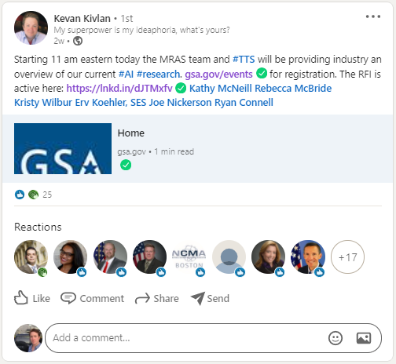
Here’s How GSA Did it Better
Notes:
https://www.publicspendforum.net/blogs/frank-mcnally/2021/02/03/is-gsa-taking-advantage-of-industry-with-their-machine-learning-artificial-intelligence-rfi/

Slide 35
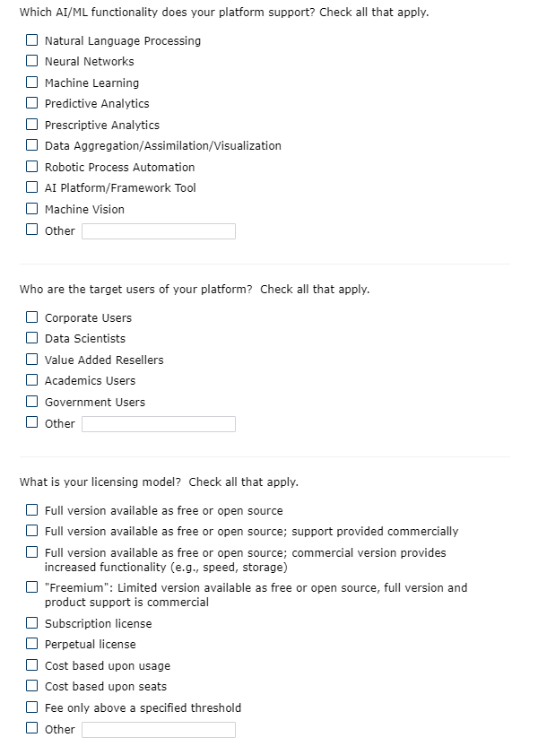
Here’s How GSA Did it Better
Notes:
Speaker Notes:
https://www.publicspendforum.net/blogs/frank-mcnally/2021/02/03/is-gsa-taking-advantage-of-industry-with-their-machine-learning-artificial-intelligence-rfi/
The whole RFI response is form-based. No additional document to create, no company letterhead to be signed by an exec and approved by legal. Using an online form makes the whole response process far less burdensome, and more likely to be completed by experts in the organization rather than the marketing professionals.
Note how much intelligence about the market has gone into simply developing this question. This acq team definitely has a strong working level knowledge.

Slide 36
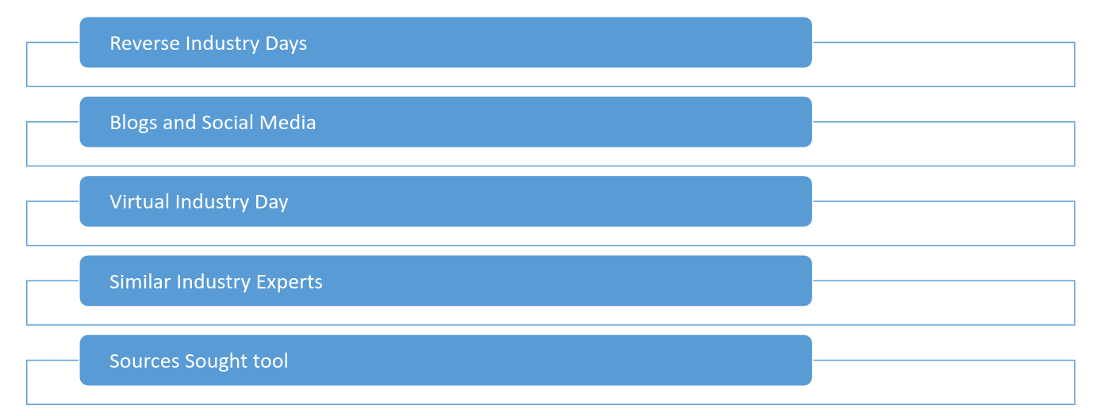
Other Ways to Go Beyond the RFI
Notes:
Speaker Notes: Open discussion/real talk. Which of these actually work, and which don’t pass the smell test?

Slide 37

Test an acquisition hypothesis
Use challenges, pilot / prototyping, or Minimum Viable Product acquisitions to determine the full solution as part of the Market Research process.
Notes:
Speaker Notes:
Challenges can be used so broadly – for ideation to figure out if there is a solution for a specific problem – such as: How do we increase automated identity proofing for the elderly or poor who don’t have regular or an understanding of utilizing technology?”
Creating a way to test an acquisition hypothesis to find out if there are solutions possible or to build the minimum viable product of a solution and then determine how it needs to be scaled can be a part of this process.

Slide 38
Create an easy-to-use, vehicle agnostic commercialized marketplace
Be able to pre-qualify industry practitioners
Standardize acquisition process for agile services
Improve range, speed, competitiveness, and quality of contracted digital service solutions
Accelerate how federal government procures services
Building an Agile Marketplace
Notes:
Facilitator Notes:
Agile Marketplace
Hypothesis: Creating an easy to use style of commercialized marketplace, which is vehicle agnostic, complete with the ability to pre-qualify industry practitioners will help standardize the acquisition process for agile services and identify who has the best chance to succeed at delivering product.
Product Vision: Improve the range, speed, competitiveness, and quality of contracted digital service solutions by accelerating the way the federal government can rapidly procure agile software development services.
Ask the Class: What are industry communication trends you have noticed in your work you did in Release 1 and 2?
This industry is not familiar with “Govvie” Speak – so trying to utilize plain language, modern technologies, and different modes of communication helps out

Slide 39
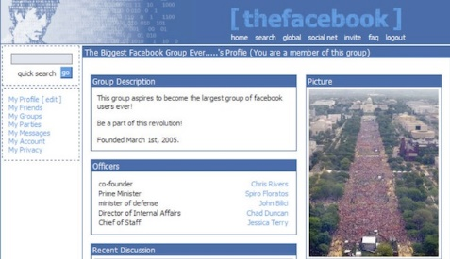
Beyond the RFI
You can go “back in time” to talk about the first version of a product as a place to start.
Look how far Facebook has come. That is the power of iteration and communication.
Facebook in 2004
Notes:
Speaker Notes:
You can go back in time as well to talk about what the first version of a product was as a place to start= if you are wanting a way to connect agency’s to other agency’s with a social media platform designed specifically for your end users you may not want to jump right to the Facebook functionality of today – but look back to what the site was in 2004.
This is the power of iteration and the power of communication.

Slide 40
“The Sources Sought tool is provided as an example of how an agency can send out using a simple web form based on questions designed around reaching non-traditional government sources or those sources who excel in providing digital services.”
TechFAR Hub
https://techfarhub.usds.gov/resources/templates-samples/
Sources sought tool
Notes:
Speaker Notes:
Introduce the Sources Sought Tool on the TechFar Hub – do a demo of the tool
SST is mentioned at the bottom of the page (Word doc download)
Have learners work in groups to identify:
Why the fields that are presented in the tool are there (e.g., show vs. tell approach, use of retrospectives) – we could have them walk through a couple of the sections like agile, open source, or user-centered research and design
How they would set up a sources sought strategy for their recommendation in the morning – what fields would be included? Why?

Slide 41
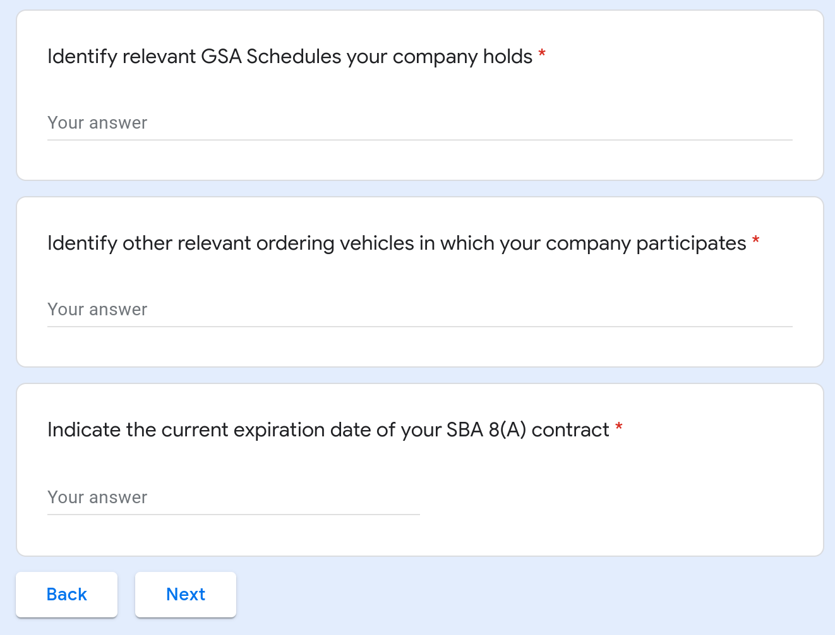
Sources Sought tool in a Word Document via TechFar Hub
Simple
Relatable
Approachable
Notes:
Speaker Notes:
Introduce the Sources Sought Tool on the TechFar Hub – do a demo of the tool
Have learners work in groups to identify:
Why the fields that are presented in the tool are there (e.g., show vs. tell approach, use of retrospectives) – we could have them walk through a couple of the sections like agile, open source, or user-centered research and design
How they would set up a sources sought strategy for their recommendation in the morning – what fields would be included? Why?

Slide 42
Group discussion
Explore and discuss the Sources Sought Tool
Notes:
Speaker Notes:
Have learners work in groups to identify:
Why the fields that are presented in the tool are there (e.g., show vs. tell approach, use of retrospectives) – we could have them walk through a couple of the sections like agile, open source, or user-centered research and design
How they would set up a sources sought strategy for their recommendation in the morning – what fields would be included? Why?

Slide 43
Break
5 minutes

Slide 44
There are emerging technology companies, along with traditional contractors, that could support an identity management digital services project.
We can use market research tactics to find companies in this space and improve our requirement.
The product/requirement hypothesis
Notes:
Speaker Notes:
Challenges can be used so broadly – for ideation to figure out if there is a solution for a specific problem – such as: How do we increase automated identity proofing for the elderly or poor who don’t have regular or an understanding of utilizing technology?”
Creating a way to test an acquisition hypothesis to find out if there are solutions possible or to build the minimum viable product of a solution and then determine how it needs to be scaled can be a part of this process.

Slide 45
Practice Non-Traditional Market Research Activity
Notes:
Speaker Notes:
Get in your teams and consider one non-traditional way to plan out how to “conduct” the market research to inform the product/requirement hypothesis.
In your team sketch out the actions that would be necessary to implement the strategy.
***
Exercise Duration: 1.5 hours
Group work time: 45 minutes; Timing: 11:30-12:15
Lunch Break: 12:15-1:15
Group Report-out/Discussion: 1:15-2:30
Facilitator Notes: We will assign each of the groups one of the methods – so they will each have the ability to talk through something different and get different answers.
Teams will report out on how they plan to conduct market research.
I think they should use their whiteboards/easles to document their main points to brief out to the class and then let the class do the Q&A about the process they took – if the class doesn’t have the right kind of questions we can have some planted.
I do think this would be a good place to talk about ASI/ICF’s research and tactics – when we get to hear about what you do we can potentially take an idea from that method.
Then, we will conduct a large group discussion:
What challenges did you have in finding the information that you were seeking?
What do you need to get more information around the market intelligence related to an industry? (e.g., trade shows, non-government technical conferences)
Discussion 1 with group: What Would You Do? – Based on the presentations, how would you move forward and what would you do? What are the next steps needed? (e.g., more research, getting stakeholders onboard)
Discussion 2: Now that they have completed their recommendations on how to move forward, what does sources sought/solicitation communication strategy look like?

Slide 46
NIDA hopes that participation in the contest will enable scientists to test the hypothesis that their research idea can be fostered into a biotech startup, and that eventually any newly created startups will contribute to the pool of innovative small business companies that can successfully compete for NIDA’s Small Business Innovation Research (SBIR) and Small Business Technology Transfer (STTR) funding.
The Acquisition
Hypothesis
Notes:
Speaker Notes:
Challenges can be used so broadly – for ideation to figure out if there is a solution for a specific problem – such as: How do we increase automated identity proofing for the elderly or poor who don’t have regular or an understanding of utilizing technology?”
Creating a way to test an acquisition hypothesis to find out if there are solutions possible or to build the minimum viable product of a solution and then determine how it needs to be scaled can be a part of this process.

Slide 47
Recap

Slide 48
What’s Next?

Slide 49
Administer & Awarding DS Contracts:
Using Metrics and Incentives
Presented by: [Facilitator Name]
Date: [Session Date]

Slide 50
Welcome back to
DITAP Training!
Digital IT Acquisition Training Professional (DITAP)
Training Program FCN 500 (CA), DITAP Foundations

Slide 51
Using Metrics and Incentives

Slide 52
Use Data Decisions
Tools for tracking Progress
Practice Building Incentives
Agenda

Slide 53
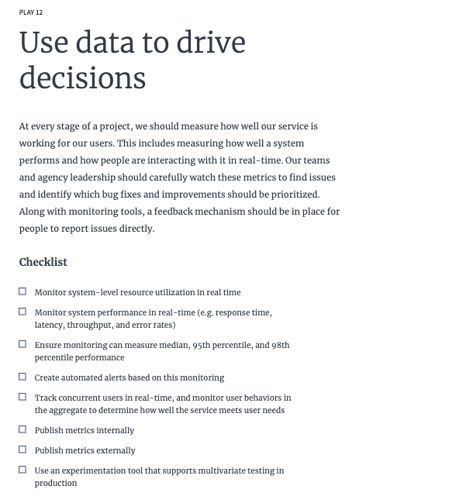
Digital Services Playbook
Playbook 12

Slide 54
Project Tracking Tools
These tools are designed to help you enter your sprints and track the progress of each person on the team:
JIRA
Trello
Axosoft
Planview AgilePlace
Miro
PlanBox
FogBugz

Slide 55
Source Control Tools
These tools are designed to help software developers maintain current and historical versions of files such as source code, web pages, and documentation for control or workflow throughout the lifecycle:
Git
Subversion
VCS
Mercurial
Azure DevOps Server

Slide 56
Build Pipeline Tools
These tools are designed for automated software builds, artifact versioning, documentation generation, testing, static analysis, and deployment:
Jenkins
Hudson
Travis CI
Bamboo
GoCD

Slide 57
System Monitoring Tools
These tools are designed to enable developers to diagnose and fix application performance problems in real time:
New Relic
Splunk
Hyperspin
StatsD with Graphite
Modern application technologies
Good logging and analytics

Slide 58
Incentives:
Practicing Building Incentives

Slide 59
There are two types of incentives: Monetary and Non-Monetary.
Monetary Incentives include some form of financial increase for the contractor.
Non-monetary incentives come in the form of recognition building a partnership and so forth.
Notes:
Speaker Notes:
As you consider whether an incentive is a good option for you, consider the following:
What do you actually want to incentivize?
Are you assigning incentives for things that are above the expected quality and on-time delivery?
Who is actually getting the award? Is it the company, or the people doing the work? What about subcontractors? Some companies look negatively on the employees if they do not achieve the incentive and do not pass down the award. If the people you are working with do not get a promised award, it can hinder your efforts to gain the contractors trust.

Slide 60
Group Discussion:
Monetary Incentives -
Award Term Contracts

Slide 61
Activity:
Finding the Right Metric

Slide 62
What’s Next?
Developing the Solicitation

Slide 63

Case Study Activity:
Solution Evaluation with SWOT Analysis
Map out the key stakeholders in the case, using Milestone 1.
Notes:
Speaker Notes:
Many government teams—and their partners—contribute to advancing digital delivery. These groups create resources, prototypes, and momentum for modern practices.

Slide 64
Sprint 2
Developing the Solicitation

Slide 65
How to Write a Statement of Objectives (SOO)
Shifting to Outcomes-Based Acquisition
Presented by: [Facilitator Name]
Date: [Session Date]
Notes:
Speaker Notes: Welcome to today's session on how to write an effective Statement of Objectives, or SOO. We’ll explore what a SOO is, when to use it, how to prepare, and best practices for drafting one that enables vendor-driven innovation and better outcomes.

Slide 66
Deliverables
Identify expected high-level deliverables (e.g., MVP, user research report, roadmap, sprint demos).
Focus on outputs and outcomes, not prescriptive tasks.

Slide 67
Performance Standards/Metrics
Define how performance and success will be evaluated.
Include relevant KPIs, service levels, or acceptance criteria.
Align metrics with the objectives listed above.

Slide 68
Constraints / Assumptions (Optional)
Identify known dependencies (e.g., data access, systems integration).
Include mandated frameworks or compliance requirements (e.g., Section 508, FedRAMP, FISMA).
Note any technology preferences, constraints, or assumptions critical to planning.

Slide 69
Best Practices for Writing a SOO
Keep concise: ~15 pages or fewer
Focus on outcomes, not detailed solutions
Use clear, plain language
Involve contracting early
Align with modular acquisition if applicable
Notes:
Speaker Notes: Aim for clarity and brevity. Focus on measurable results and leave room for vendors to propose the best method. Coordinate early with your contracting team to ensure alignment.

Slide 70
Common Pitfalls to Avoid
Writing a SOW disguised as a SOO
Overloading with technical specs
Vague or unmeasurable objectives
No clear success criteria
Notes:
Speaker Notes: Avoid the temptation to revert to detailed instructions. Focus on the "what" and define success metrics. These are essential to evaluating proposals and measuring contractor performance.

Slide 71
After the SOO is Drafted
Review with:
Legal
Contracting
Program leadership
Use it to:
Guide industry engagement (e.g., draft RFP, industry day)
Enable vendors to propose SOW or PWS in response
Notes:
Speaker Notes: After drafting, share the SOO for internal review. Then use it externally to engage with industry, gather feedback, and let vendors develop their SOW or Performance Work Statement in response.

Slide 72
Final Thoughts
A well-written SOO empowers vendors and supports better outcomes
Drives innovation and mission alignment
Builds a strong foundation for performance-based acquisitions
Notes:
Speaker Notes: SOOs are powerful tools when done right. They not only promote innovation but also help the government achieve better mission outcomes. Use them thoughtfully and strategically to deliver real value.

Slide 73
What is a SOO?
High-level objectives and desired outcomes
Enables vendor innovation
Focuses on what the government wants, not how to do it
Notes:
Speaker Notes: A SOO outlines what the government wants to achieve, not how to achieve it. This encourages vendors to propose innovative and flexible solutions tailored to those objectives, unlike the prescriptive nature of a traditional Statement of Work.

Slide 74
When to Use a SOO
Vendor-driven solutions desired
Outcomes are iterative, agile, or evolving
Innovation and continuous improvement are needed
Scope is service-oriented with flexible execution
Notes:
Speaker Notes: SOOs are ideal when you're looking for creativity, especially for services or digital solutions that evolve over time. They’re perfect for iterative work, like agile development or continuous improvement contracts.

Slide 75
Preparation Before Writing
Engage early with:
Technical leads
End users
Legal, finance, and contracting
Define product vision and desired outcomes
Notes:
Speaker Notes: Preparation is essential. Involve key stakeholders early to align on the mission, define what success looks like, and ensure compliance with all necessary guidance.

Slide 76
Understand BANT Framework
Budget: Confirm funding is in place
Authority: Identify decision-makers
Need: Align to mission and urgency
Timeline: Identify constraints and priorities
Notes:
Speaker Notes: Use the BANT framework to check your acquisition readiness. A well-developed SOO begins with clarity around these four critical elements.

Slide 77
Policy and Guidance Check
Review:
FAR Part 37
FAM/FAH
DOSAR
Agency-specific templates and guides
Notes:
Speaker Notes: Make sure your SOO complies with all applicable policies. FAR Part 37, for instance, supports performance-based acquisition, which is the foundation of the SOO format.

Slide 78
Background
Briefly describe the program, mission need, or problem to solve.
Summarize the current environment (technical, organizational, or operational).
Mention any prior efforts, pilots, or legacy systems relevant to the effort.

Slide 79
Scope
Describe the general nature of the work without prescribing specific solutions.
Identify key users, stakeholders, or beneficiaries.
Include any known constraints (e.g., regulatory, technical stack, geographic limits).

Slide 80
Objectives
List 3–6 clear, outcome-based objectives the vendor must meet. Each objective should be:
Measurable and aligned with mission outcomes.
Flexible enough to allow for vendor innovation.
Examples:
Improve the user experience of the visa application portal.
Reduce FOIA request processing time by 30%.
Deliver a functional MVP within 90 days of contract award.

Slide 81
Case Study Activity:
Evaluating Data Security Solutions with SWOT & Cost Estimation
Map out the key stakeholders in the case, using Milestone 1.
Notes:
Speaker Notes:
Many government teams—and their partners—contribute to advancing digital delivery. These groups create resources, prototypes, and momentum for modern practices.

Slide 82
Sprint 3
Running a Successful Evaluation

Slide 83
Case Study Activity:
Designing a Solicitation Strategy
Map out the key stakeholders in the case, using Milestone 1.
Notes:
Speaker Notes:
Many government teams—and their partners—contribute to advancing digital delivery. These groups create resources, prototypes, and momentum for modern practices.

Slide 84
Administer & Awarding DS Contracts
Session: Select a Technical Evaluation Team with the Necessary Skills

Slide 85
Welcome back to
DITAP Training!
Digital IT Acquisition Training Professional (DITAP)
Training Program FCN 500 (CA), DITAP Foundations

Slide 86
Purpose of Evaluation Criteria
Evaluation criteria ensure:
Transparency & Fairness
Objectivity & Accountability
Efficiency & Value for Money
Risk Management
Public Confidence & Legal Protection
Notes:
Speaker Notes: Well-crafted evaluation criteria enable a fair and transparent process. They help manage risk, ensure public confidence, and legally protect the acquisition outcome. Without clear criteria, source selections risk challenge and inconsistency.

Slide 87
Best Practices for Evaluation Criteria
Clarify requirements & procurement objectives
Engage stakeholders early
Categorize & prioritize criteria (technical, management, cost)
Assign weights & use clear, measurable standards
Separate past performance (reliability) from past experience (innovation)
Notes:
Speaker Notes: Best practices start with stakeholder engagement and a deep understanding of what matters most for the mission. Criteria should be clear, measurable, and aligned with both risk appetite and mission impact. Always distinguish between past performance and past experience—they serve different purposes.

Slide 88
Summary & Key Takeaways
Clarify requirements & procurement objectives
Agile acquisition emphasizes flexibility, collaboration, and user value
Multi-phased, interactive evaluation is key
Match evaluation method to procurement goals
Thoughtful criteria drive fairness and mission success
Hybrid evaluation models are powerful tools
Notes:
Speaker Notes: To close: Agile acquisition and modern evaluation methods enable better outcomes for the mission. A phased, interactive process helps us assess vendor fit beyond static proposals. Choosing the right evaluation method—and crafting strong, mission-aligned criteria—are keys to success.

Slide 89
Consider a Technical Exchange Meeting
Why hold a technical exchange meeting?
Opportunity to engage SMEs and stakeholders (future evaluators) to help increase their buy in for the process
Walk through the strategy, especially if you are using any innovative strategies that need to be socialized (orals, industry days, challenges)
Who will be involved and what are the roles?
Do they have any feedback on how to make it better?
Consider an important question: is what we are trying to achieve with this solicitation and evaluation process actually realistic?

Slide 90
Before the Source Selection Meeting
Some things to do to prepare yourself
Individual touch points with all the candidates - help them understand their responsibilities and what you’re going to do to make the process efficient
Is a meeting with chief counsel required?
Ensure there is approval from their supervisory chain - being on an evaluation team can take a lot of time and effort
Do you require a dedicated space for the evaluation?
If so, get on that early!

Slide 91
Before the Source Selection Meeting
Some things to do to prepare your evaluation team
Train them on the acquisition (what are you buying, why are you buying it, how it will be procured)
Any relevant learnings from market research
What success looks like (definition of done)
Characteristics of ideal outcomes
How the source selection process will work
Do they need to keep notes
Will debriefings be offered
What to do if they have questions
What is being evaluated and what is not

Slide 92

What if the Program Office Is Not Prioritizing the Evaluation Process?
Tips for CYA
Limit the period of performance
Escalate the issue
Find success (and failure) stories from similar acquisitions
Document the file!

Slide 93
What’s Next?
Negotiating Trade-offs

Slide 94
Who Are Our Stakeholders?
How Can We Relate To Them (Strategically)
What Do We Want to Achieve With Our Stakeholders?
Agenda

Slide 95
Select a Technical Evaluation Team with the Necessary Digital Skills

Slide 96
Tech Evaluation Panel Checklist
Group Activity
Notes:
Activity: Tech Evaluation Panel Checklist
There is a accompanying pdf handout for this activity https://drive.google.com/file/d/1ZZXua9F6wNNYfyh_1tvZ8__8sCqdCPhW/view?usp=drive_link
INSTRUCTIONS
Building off of the what you learned earlier in the program, items and the resources you reviewed in the online learning, we will build a checklist of ways to determine the technical evaluation panel’s skillset relative to the digital service they will be asked to evaluate.
What questions would you add to the list? What other techniques might you use?
You should post additions to the checklist in chat. Refer back to Iteration 3.B’s Top Evaluation Criteria Activity. To flag which checklist items you contributed, add your name in parenthesis at the end.
DEFINITION OF DONE
Post two new additions to the checklist on the Slack by the last day of this iteration.

Slide 97
Have you…
Mapped your instructions to your evaluation criteria?
Created guides and/or tools to help your evaluation team complete their responsibilities?
Met with chief counsel to get guidance on how to run your source selection without creating bias or increasing the odds of a protest?
Requested the program begin thinking about evaluation team members

Slide 98
Six Traits of Effective Evaluation Team Members
Thorough knowledge of the domain, products & services
Strong oral and written communication skills
Ability to work cooperatively and professionally to come to a consensus
Has the knowledge and appreciation to protect source sensitive information
Free from personal conflicts of interest
Available and with bandwidth to dedicate to completing the source selection

Slide 99
Agile Acquisition Overview
Agile acquisitions start with traditional steps: need definition, market research, alternatives analysis
Diverges after strategy selection—focuses on:
Flexibility
Collaboration
Iterative validation
"Show, don’t tell" evaluation
Notes:
Speaker Notes: Agile acquisition builds on familiar procurement steps but quickly shifts to a user-centered, flexible approach. We prioritize working solutions and collaborative validation, rather than long written documentation. Agile also changes how we evaluate vendors—favoring what they can show, not just what they say.

Slide 100
Agile Source Selection Process
Multi-phase "Down-Select":
White paper submission → early screening
Interactive evaluations: demos, solution walkthroughs, team presentations
Collaborative Negotiation (Alpha Contracting):
Co-development of PWS, implementation plan, QA metrics
Notes:
Speaker Notes: Agile acquisition uses a phased evaluation approach. We start with lightweight submissions and move to interactive evaluation. Once a vendor is selected, we co-develop key documents together—driving alignment and ownership of outcomes.

Slide 101
Evaluation Methods Overview
Comparative Evaluation
Side-by-side comparison of proposals
Flexible & efficient—suited for agile and iterative efforts
Best-Value Trade-Off
Balances price & non-price factors
More structured—used for complex, mission-critical procurements
Notes:
Speaker Notes: Choosing the right evaluation method is key. Comparative evaluation offers speed and flexibility—ideal for agile and commercial solutions. Best-value trade-offs provide deeper documentation and risk analysis—better for high-risk, complex acquisitions.

Slide 102
Technical Evaluation Tips for Agile
Techniques for Evaluating Agile Contractor Capability
Presented by: [Facilitator Name]
Date: [Session Date]
Notes:
Speaker Notes:
Welcome. This session focuses on how contracting professionals can evaluate vendor capability for Agile software development. We'll cover evaluation techniques, best practices, and how to structure your solicitation to ensure alignment with Agile principles.

Slide 103
Why Agile-Specific Evaluation Matters
Using Oral Presentations Strategically
Agile-Integrated Evaluation Criteria
Asking the Right Agile-Specific Questions
Evaluating Demonstrated Agile Experience
Keeping Work In-Scope Post-Award
Structuring the SOO for Agile Success
Agenda

Slide 104
Why Agile-Specific Evaluation Matters
Agile requires iterative planning and delivery
Traditional evaluation methods may miss key capabilities
Goal: Assess true Agile fluency, not just proposal polish
Notes:
Speaker Notes: Evaluating Agile contractors means assessing their ability to deliver working software iteratively, engage end users, and adapt quickly. This requires going beyond traditional technical narratives and digging into how teams actually plan, build, test, and learn.

Slide 105
Use Oral Presentations Strategically
Use to assess Agile knowledge and delivery maturity
Include oral presentation intent in solicitation language
Conduct post-competitive range to ensure fairness
Record and tightly control sessions
Notes:
Speaker Notes: Oral presentations can be a powerful tool to distinguish between teams that understand Agile in theory and those that can apply it in practice. Clearly define how you’ll use these presentations and include them as part of your evaluation criteria.

Slide 106
Agile-Integrated Evaluation Criteria (Sample Factors)
Factor 1: Performance Work Statement tied to Agile
Factor 2: Product Development Roadmap with iterations
Factor 3: Notional Quality Control Plan with Agile metrics
Notes:
Speaker Notes: Integrating Agile into your technical evaluation factors ensures that vendors must show how their process aligns with Agile delivery. These examples show how to evaluate for contract management, communication, release planning, and quality measurement—all in an Agile context.

Slide 107
Ask Agile-Specific Questions
Sprint planning & release cycles
End-user engagement
Lessons learned & adaptation
Agile team composition
Configuration management
Talent alignment with product vision
Notes:
Speaker Notes: You want more than a glossy proposal—you need to understand how the team actually works. Ask questions that expose their discipline in Agile execution, responsiveness to feedback, and how they tailor the team to the project’s needs.

Slide 108
Evaluate Demonstrated Agile Experience
Include past performance in Agile delivery
Request samples (e.g., code, sprint outcomes)
Emphasize iterative delivery, user testing, MVP success
Notes:
Speaker Notes:
Make Agile experience a formal evaluation factor. Ask for concrete examples—like delivered code or user-tested iterations. This allows you to see not just what they’ve done, but how they’ve delivered value through Agile.

Slide 109
Keeping Work In-Scope Post-Award
Align scope with Product Vision & SOO
Make Agile framework explicit in solicitation
Use MVP definition, service levels, and metrics to guide refinements
Notes:
Speaker Notes:
FAR permits post-award refinements if the work remains within scope. Defining scope around a Product Vision and using Agile delivery frameworks allows requirements to evolve while staying within contract boundaries. Include Agile expectations up front to avoid protest risk.

Slide 110
Structuring the SOO for Agile Success
Define outcomes, not prescriptive tasks
Fix timeframe, allow offerors to propose sprints
Define outcomes, not prescriptive tasks
Fix timeframe, allow offerors to propose sprints
Notes:
Speaker Notes:
A well-structured SOO sets broad outcomes, establishes schedule boundaries, and invites

Slide 111
Administer & Awarding DS Contracts:
Negotiating Trade-offs

Slide 112
Welcome back to
DITAP Training!
Digital IT Acquisition Training Professional (DITAP)
Training Program FCN 500 (CA), DITAP Foundations
Notes:
1250 Breakout Rooms

Slide 113
Consider the intended outcomes of negotiating public sector contracts
Review negotiation basics
Practice strategies and techniques to help you determine appropriate trade-offs
Agenda
Notes:
[Read First]
We start to talk about going from the planning to solicitation through award.
Talk about negotiating tradeoffs.
What are we doing; what are we trying to achieve when we negotiate
What are some of the basics of negotiating
Practice some techniques to help to determine tradeoffs
[Then Slide … “to recap”]

Slide 114
Negotiating Trade-offs
Time: 60 minutes

Slide 115

What is the Purpose of Negotiation in Government Contracting?
Save the Government $
Acquire the right product/service
Help both parties arrive at an acceptable outcome
Ensure you are hiring the correct contractor
Notes:
Speaker Notes: [We’re going to start with an activity. You can only answer 1 – do not say “it depends”]
[read the question and then]
[Read all 4 to the class]
[Just drop the answer into the chat]
---
1) Yes, we do want to save the gov $. Primary negotiating objective? Not necessarily. Could be
2) Of course, but we should not be negotiating with contractors that we haven’t already determined are the right fit (ideally w/ best value)
3) Ding ding ding
4) You shouldn’t be negotiating with someone that isn’t the right contractor … not saying they’ll earn the ultimate deal, but you’re negotiating with the right purpose, so our purpose is to arrive at an acceptable outcome

Slide 116
Is it a Good Thing When Contractors Make a Profit?
Yes
No
Notes:
Speaker Notes: [Read the question; drop answers in the chat]
Who thinks it’s yes; or no …
Sure, most people will answer yes, but most people want to try and limit their expenses …
Repair on your home etc. Going to cost 5K, but bid is 7.5K. You likely don’t want to pay 2.5 more …
But, profit is motive, profit is incentive.
What does a good contractor do with profit ideally? Pose to the group?
Reinvest in their product (R&D) / company
Compensate high quality people
Very important for a company to make profit … no innovations on that iphone, etc.
Healthy profit v. unhealthy profit … there’s a balance there. No one wants to get screwed.
I’m getting married … wedding planner … lots of different thoughts … 20% less on a “party” v. “wedding” … bilked

Slide 117
What is the Ultimate Objective in Negotiating a Government Contract?
Get the lowest possible cost
Squeeze the contractor for everything they’re worth
Get all of our objectives and terms incorporated into the final deal
Arrive at a win-win outcome that supports both the government and the contractor.
Notes:
Speaker Notes: [Read the title question]
Different than the purpose question … drop your answers in the chat.
[Read all four options]
4 is the right answer, but when you meet with your team, does #4 always play out … no, no it doesn’t.
Gov will draw a hard line, especially with recompetes … you’ll accept lower prices or you don’t get the contract.
Contractors also not innocent … “gov has oodles of $’
The issues come when the bruises from an unhealthy negotiation can ride through the entire PoP, on another contract, etc.
If you win through brute force, relationship will be hard, performance will be hard
Win/win is good. Feel good; but not great. Work in a healthy environment moving forward.
Thanks for contributing … definitely some gray area…

Slide 118
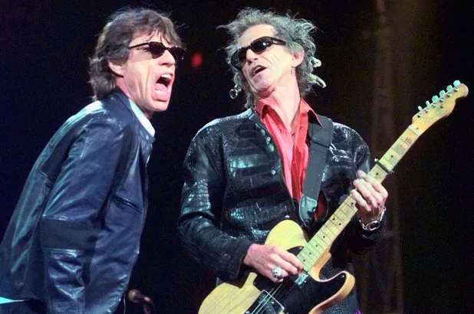
Trade-Offs: Because You Can’t Always Get What You Want...
Notes:
Speaker Notes: You’re going to have to make tradeoffs; going to have to come to the table honestly; you’ll get what you need

Slide 119
Negotiation Concepts
BAFO = Best and Final Offer
Win-Win vs. Win-Lose
Walk Away Point
Notes:
Speaker Notes: Let’s review some negotiating concepts real quick.
[Read the four]
BAFO – tons of negotiation strategy (not today’s class). You don’t lead with the price you want to achieve. First # isn’t going to be where it ends up, wish we could cut through the noise … sometimes you will see that.
With digital services, negotiation is important. We’re not buying commodities … we’re not buying PPE, right. Ex: if there’s a ton of inventory, give us your BAFO.
Versus .. If we’re doing a website build, probably don’t want a BAFO … want to talk through w/ them, make sure they understand the scope / the requirement.
---
BATNA – anyone heard of this? When does this come into play …
You’re in a situation where you cannot come to agreement and mutuality likely not to be achieved. “best case scenario in the event the worst case happens”
Ex: working w/ incumbent, and just can’t get there on exercising an option.”
the batna would be a 6 months extension at the current price rate so they can go out an recompete. Need to have a batna as a fall back plan … could be a descoped version of something to give you time to go back out to the market.
Important to have this; have your leadership sign this off … don’t want to be in a situation where something needs to be turned off (vital systems), etc.
---
Win-win v win-lose
Want to get to win-win but … we can’t always.
We don’t want vendors feeling like they are losing; will create ill will
---
Also need that walk away point; vendors will have one. Gov should to – maybe a price level, minimum security standard …
Don’t lead with your walk away point – normally. You need to know what that is though
Lot of this will depend on minimum functionality; must haves, etc.

Slide 120
General Tradeoffs in Government Contracting
Price
Contract type
Delivery schedule
Business terms and conditions
Labor mix
Notes:
General tradeoffs in Govcon:
Read all of them, then explain:
Price – pay a little bit for more service. Is price that important? Sometimes, but sometimes willing to spend more to get a better product
Contract type – could convert a contract from labor hour to a fixed price; or vice versa; could be a contractor preference. Anyone ever do this? These discussions help you learn their rationale.
Delivery schedule – another big trade off … for anyone working on time sensitive contracts, willing to pay more for faster performance and delivery
Business terms and conditions – intellectual property is a big one; delivering something custom or w/ unique processes and you want data rights, Contractor says I’m going to charge you a premium since I could have traded on the market. You as gov could say, we’ll let you maintain the IP and you could go resell it, but we want you to cut your costs by 25%
Labor mix – you have a top line number you can’t exceed, you can get there by looking at your labor mix, how many associates you have on here … make sure it’s not top heavy … partner and director roles … seeing a lot of those … these guys don’t do a lot of work on your project. Work normally coming from mid level folks. Ask them what they are doing … in office? On sprint meetings? If they are active, sure … but better be a defensible position. Reduce overthead!
a really good agile Labor mix - you'll see a heavy developer costs lots of ui ux rates anywhere from $90 to $200 an hour, maybe a little higher but, again, you want to be paying the Doers not the administrators and these types of service contracts.

Slide 121
What Types of Trade-Offs Do We Make When Buying Digital Services?
Security vs. Access/Convenience
Security vs. Uptime/Availability
Regulations/Protections vs. Efficiency/Burden
Cost vs. Feature/Benefit/Service
Cost vs. Quality
Cost vs. Effort/Resources
Utility vs. Design
Personalization/Customization vs. Scale/Applicability
Privacy vs. Transparency
Notes:
Ask: Any ideas? Features, security, compliance?
Ask: What would be a technical tradeoff specific to digital service?
Real life example … teenager buys a volvo versus a Porsche
Back to digital … mvp versus gold plated solution; beta builds; implementation time (pay to load up your engineer team, if you can get that process implemented earlir)
---
Security vs. Access/Convenience … 2factor authentication is more secure but it take a bit of time … protecting pii
Security vs. Uptime/Availability … cloud … high availability … you can get it, but more expensive
Regulations/Protections vs. Efficiency/Burden …
creating a fixed price type of construct for agile software development, we always would prefer to have fixed price contracts, but don't you think we could be more efficient in an agile development project if we were only paying Labor hours? Probably – but now you need a product owner actively manage that contract.
Cost vs. Feature/Benefit/Service … no brainer. Want the best service for your constituents, may be more expensive.
Cost vs. Quality … higher quality > last longer; reservice costs lower; others may want quantity over quality …
Cost vs. Effort/Resources
Utility vs. Design … important tradeoff in user experience; kind of goes back to the login … sacrifice design over utility? A negotiation
Personalization/Customization vs. Scale/Applicability … former costs more but may be easier to scale, etc.
Privacy vs. Transparency … talking about data transparency; not pii

Slide 122
Not just evaluation…
User wants and needs
Program wants and needs
Regulatory requirements and best procurement outcomes
During product roadmap development
During sprint/iteration planning
Notes:
Speaker Notes: But how will you know?
Not just doing tradeoffs when we’re doing eval and negotiation
Doing w/ users and needs
with program and their needs
with policies/regulations – should it be part of my contract; is there a permissible exercise of authority
[Back to slide]

Slide 123
Trade-offs don’t make themselves…
Make a list of all the features or attributes you want
User stories are a great resource for this
Identify any features that are critical or non-negotiable
“Must points”
Identify issues that are open to concession
“Give points”
Identify issues that are weak points for your position
“Avoid points”
What remains are features/attributes that may or may not be delivered
“Bargaining points”
Notes:
Going from our list of attributes to the must, give, avoid & bargaining points is not always straightforward. We can use some techniques to assist us. Namely...
User stories are great. Example: figure out your user story related to an absolute minimum viable feature … back to the wedding example
[then read slide]
Another example: back to acquisition … you’re behind on palt, towards end of fiscal, you need this on contract; contractors know you’re not going to be as hard in September as you are in November, so figure out what you can give and can’t give. Maybe don’t talk about cost … focus on something else
All of this points back to a need to continuously do market research … why you’re in this class, you understand digital services, this industry, so come time for negotiating, tradeoffs, okay
So how do we do it?

Slide 124

Notes:
...the Matrix! Wait, not that matrix...

Slide 125
Break
Time: 5 minutes

Slide 126
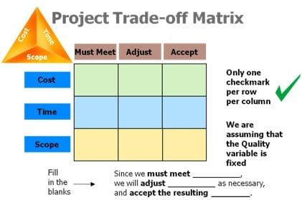
Use A Trade-Off Matrix to Help Determine What Matters Most
Credit: https://simulationpl.com/blog/newsletters/stakeholders-and-the-triple-constraint-trade-off-matrix/
Notes:
JONATHAN: CAN WE GET A BETTER GRAPHIC?
How can you maximize the attributes involved in a tradeoff?
Use a tradeoff matrix
Sit down with program office
What can you trade off and cannot
Cost, Time, and Scope … the iron triangle
Things you must meet, things you adjust, things you accept
Cost – do you have a fixed budget? MUST MEET
Budget flexible – you can then adjust
Time – does it have to be on schedule? No … you can adjust
Matrix helpful when prepping for negotiation

Slide 127
Using Trade-Offs to Prioritize Features
Degree of Difficulty vs. Value
Difficulty
Value
Notes:
This is a more familiar quad maxis …
Difficulty on one axis; value on another axis.
How difficult is a feature v. how valuable
Ex: top right, really hard to achieve but very valuable = don’t trade off
Ex: not valuable; not difficult … can give it away; or be cute and fake em out …
Things that are valuable and very difficult, hard to get; things not difficult but valuable, can get those

Slide 128
Exercise: Use this Matrix To Prioritize the Features of your Project
Level of Effort vs. Impact on Outcome
Level of Effort
Impact

Slide 129
Use One of the Matrices to Prioritize the Features of your Group Project
Take 15 minutes to discuss as a team
Assign one member to provide a two minute debrief on what matrix you choose and why you chose it
Notes:
Breakout rooms for capstone project … choose a matrix, assign a member to come back and tell us why you picked that matrix … and use it to do some tradeoffs you’re going to make on your capstone project.
What matrix worked … what’s on your x axis v. y axis.
---
Come back … how was the dialogue? This is important …
Let’s go from one Capstone group to another …
---
When we wrap, hope you got a sense, if you haven’t yet, people take positions … positions get personalized … natural emotion, but not always the right emotion. Some folks will feel more strongly about other features, etc.

Slide 130
Preparing for the Negotiation:
How to Achieve the Win

Slide 131
Who Do You Want on Your Negotiation Team?
Team Leader
Technical Analyst
Price Analyst
Business Analyst
Legal
What characteristics are most desirable in these roles?
Notes:
Speaker Notes:
You’ll need these people.
it's really important that you have somebody who is there that can sign the contract to who can execute the deal
and it's always a really important question to ask the other party, do you have somebody here today that can accept this deal and sign off
if you don’t, you're not negotiating.
If not, terminate the meeting
Both parties need signatory

Slide 132
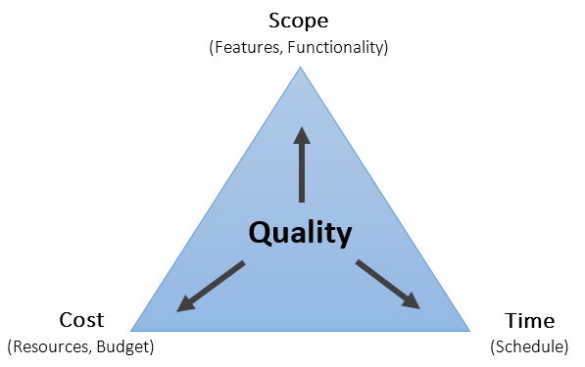
How to Perceive What the Other Side Values
Use these strategies
Pre-Negotiation: Put yourself in their shoes
What constraints do they have?
What pressures do they have?
What do they need to feel or be successful?
During Negotiation: Ask Open Ended Questions
What if…
Would you consider…
How would it impact…
Notes:
It’s all about finding the pressure points
[read off the slides]
Asking questions … get good feedback …
ALSO FEEL FREE TO TAKE A BREAK
Source: https://www.karrass.com/en/negotiation-strategies-tactics-how-to-negotiate-better-deals

Slide 133
Factors that Influence the Ability to Make Trade-Offs
Other party’s bargaining power
Incumbent vs. new competitor
Business size and status
Competitive field
Uniqueness of the product or service
Information Symmetry
How well do you know what you’re buying?
Time and Schedule Constraints
-If the program needed it yesterday…
Scarcity, logistics, location
Notes:
[READ THE SLIDE]
Information symmetry – market research
Strategic market research – will know more about a market/industey
Tactical market research – specific product
Last one – think about PPE during COVID …

Slide 134
Consider these three questions
What result do you feel is most reasonable based on the available information?
What is the most desirable result that you could reasonably expect to achieve on this issue?
What is the least desirable result that you would be willing to accept on this issue?
Notes:
Speaker Notes: Pro Tip - pretend one of your least important issues is a big deal, and then concede it to get something you want.

Slide 135
7 Principles of Effective Negotiation
https://www.bizjournals.com/bizjournals/how-to/growth-strategies/2017/08/7-principles-for-effective-negotiations.html
https://www.acq.osd.mil/dpap/cpf/docs/contract_pricing_finance_guide/vol5_ch3.pdf

Slide 136
What’s Next?
Select a Technical Evaluation Team with the Necessary Skills

Slide 137
Evaluation Criteria Overview

Slide 138
Agile Acquisition Overview
Agile acquisitions start with traditional steps: need definition, market research, alternatives analysis
Diverges after strategy selection—focuses on:
Flexibility
Collaboration
Iterative validation
"Show, don’t tell" evaluation
Notes:
Speaker Notes: Agile acquisition builds on familiar procurement steps but quickly shifts to a user-centered, flexible approach. We prioritize working solutions and collaborative validation, rather than long written documentation. Agile also changes how we evaluate vendors—favoring what they can show, not just what they say.

Slide 139
Agile Source Selection Process
Multi-phase "Down-Select":
White paper submission → early screening
Interactive evaluations: demos, solution walkthroughs, team presentations
Collaborative Negotiation (Alpha Contracting):
Co-development of PWS, implementation plan, QA metrics
Notes:
Speaker Notes: Agile acquisition uses a phased evaluation approach. We start with lightweight submissions and move to interactive evaluation. Once a vendor is selected, we co-develop key documents together—driving alignment and ownership of outcomes.

Slide 140
Evaluation Methods Overview
Comparative Evaluation
Side-by-side comparison of proposals
Flexible & efficient—suited for agile and iterative efforts
Best-Value Trade-Off
Balances price & non-price factors
More structured—used for complex, mission-critical procurements
Notes:
Speaker Notes: Choosing the right evaluation method is key. Comparative evaluation offers speed and flexibility—ideal for agile and commercial solutions. Best-value trade-offs provide deeper documentation and risk analysis—better for high-risk, complex acquisitions.

Slide 141
Purpose of Evaluation Criteria
Evaluation criteria ensure:
Transparency & Fairness
Objectivity & Accountability
Efficiency & Value for Money
Risk Management
Public Confidence & Legal Protection
Notes:
Speaker Notes: Well-crafted evaluation criteria enable a fair and transparent process. They help manage risk, ensure public confidence, and legally protect the acquisition outcome. Without clear criteria, source selections risk challenge and inconsistency.

Slide 142
Best Practices for Evaluation Criteria
Content:
Clarify requirements & procurement objectives
Engage stakeholders early
Categorize & prioritize criteria (technical, management, cost)
Assign weights & use clear, measurable standards
Separate past performance (reliability) from past experience (innovation)
Notes:
Speaker Notes: Best practices start with stakeholder engagement and a deep understanding of what matters most for the mission. Criteria should be clear, measurable, and aligned with both risk appetite and mission impact. Always distinguish between past performance and past experience—they serve different purposes.

Slide 143
Summary & Key Takeaways
Content:
Agile acquisition emphasizes flexibility, collaboration, and user value
Multi-phased, interactive evaluation is key
Match evaluation method to procurement goals
Thoughtful criteria drive fairness and mission success
Hybrid evaluation models are powerful tools
Notes:
Speaker Notes: To close: Agile acquisition and modern evaluation methods enable better outcomes for the mission. A phased, interactive process helps us assess vendor fit beyond static proposals. Choosing the right evaluation method—and crafting strong, mission-aligned criteria—are keys to success.

Slide 144
Classroom 4:
Administer & Awarding DS Contracts
Session: Select a Technical Evaluation Team with the Necessary Skills

Slide 145
Welcome back to
DITAP Training!
Digital IT Acquisition Training Professional (DITAP)
Training Program FCN 500 (CA), DITAP Foundations

Slide 146
Who Are Our Stakeholders?
How Can We Relate To Them (Strategically)
What Do We Want to Achieve With Our Stakeholders?
Agenda

Slide 147
Select a Technical Evaluation Team with the Necessary Digital Skills

Slide 148
Tech Evaluation Panel Checklist
Group Activity
Notes:
Activity: Tech Evaluation Panel Checklist
There is a accompanying pdf handout for this activity https://drive.google.com/file/d/1ZZXua9F6wNNYfyh_1tvZ8__8sCqdCPhW/view?usp=drive_link
INSTRUCTIONS
Building off of the what you learned earlier in the program, items and the resources you reviewed in the online learning, we will build a checklist of ways to determine the technical evaluation panel’s skillset relative to the digital service they will be asked to evaluate.
What questions would you add to the list? What other techniques might you use?
You should post additions to the checklist in chat. Refer back to Iteration 3.B’s Top Evaluation Criteria Activity. To flag which checklist items you contributed, add your name in parenthesis at the end.
DEFINITION OF DONE
Post two new additions to the checklist on the Slack by the last day of this iteration.

Slide 149
Have you…
Mapped your instructions to your evaluation criteria?
Created guides and/or tools to help your evaluation team complete their responsibilities?
Met with chief counsel to get guidance on how to run your source selection without creating bias or increasing the odds of a protest?
Requested the program begin thinking about evaluation team members

Slide 150
Six Traits of Effective Evaluation Team Members
Thorough knowledge of the domain, products & services
Strong oral and written communication skills
Ability to work cooperatively and professionally to come to a consensus
Has the knowledge and appreciation to protect source sensitive information
Free from personal conflicts of interest
Available and with bandwidth to dedicate to completing the source selection

Slide 151
Agile Acquisition Overview
Agile acquisitions start with traditional steps: need definition, market research, alternatives analysis
Diverges after strategy selection—focuses on:
Flexibility
Collaboration
Iterative validation
"Show, don’t tell" evaluation
Notes:
Speaker Notes: Agile acquisition builds on familiar procurement steps but quickly shifts to a user-centered, flexible approach. We prioritize working solutions and collaborative validation, rather than long written documentation. Agile also changes how we evaluate vendors—favoring what they can show, not just what they say.

Slide 152
Agile Source Selection Process
Multi-phase "Down-Select":
White paper submission → early screening
Interactive evaluations: demos, solution walkthroughs, team presentations
Collaborative Negotiation (Alpha Contracting):
Co-development of PWS, implementation plan, QA metrics
Notes:
Speaker Notes: Agile acquisition uses a phased evaluation approach. We start with lightweight submissions and move to interactive evaluation. Once a vendor is selected, we co-develop key documents together—driving alignment and ownership of outcomes.

Slide 153
Evaluation Methods Overview
Comparative Evaluation
Side-by-side comparison of proposals
Flexible & efficient—suited for agile and iterative efforts
Best-Value Trade-Off
Balances price & non-price factors
More structured—used for complex, mission-critical procurements
Notes:
Speaker Notes: Choosing the right evaluation method is key. Comparative evaluation offers speed and flexibility—ideal for agile and commercial solutions. Best-value trade-offs provide deeper documentation and risk analysis—better for high-risk, complex acquisitions.

Slide 154
Purpose of Evaluation Criteria
Evaluation criteria ensure:
Transparency & Fairness
Objectivity & Accountability
Efficiency & Value for Money
Risk Management
Public Confidence & Legal Protection
Notes:
Speaker Notes: Well-crafted evaluation criteria enable a fair and transparent process. They help manage risk, ensure public confidence, and legally protect the acquisition outcome. Without clear criteria, source selections risk challenge and inconsistency.

Slide 155
Best Practices for Evaluation Criteria
Clarify requirements & procurement objectives
Engage stakeholders early
Categorize & prioritize criteria (technical, management, cost)
Assign weights & use clear, measurable standards
Separate past performance (reliability) from past experience (innovation)
Notes:
Speaker Notes: Best practices start with stakeholder engagement and a deep understanding of what matters most for the mission. Criteria should be clear, measurable, and aligned with both risk appetite and mission impact. Always distinguish between past performance and past experience—they serve different purposes.

Slide 156
Summary & Key Takeaways
Clarify requirements & procurement objectives
Agile acquisition emphasizes flexibility, collaboration, and user value
Multi-phased, interactive evaluation is key
Match evaluation method to procurement goals
Thoughtful criteria drive fairness and mission success
Hybrid evaluation models are powerful tools
Notes:
Speaker Notes: To close: Agile acquisition and modern evaluation methods enable better outcomes for the mission. A phased, interactive process helps us assess vendor fit beyond static proposals. Choosing the right evaluation method—and crafting strong, mission-aligned criteria—are keys to success.

Slide 157
Consider a Technical Exchange Meeting
Why hold a technical exchange meeting?
Opportunity to engage SMEs and stakeholders (future evaluators) to help increase their buy in for the process
Walk through the strategy, especially if you are using any innovative strategies that need to be socialized (orals, industry days, challenges)
Who will be involved and what are the roles?
Do they have any feedback on how to make it better?
Consider an important question: is what we are trying to achieve with this solicitation and evaluation process actually realistic?

Slide 158
Before the Source Selection Meeting
Some things to do to prepare yourself
Individual touch points with all the candidates - help them understand their responsibilities and what you’re going to do to make the process efficient
Is a meeting with chief counsel required?
Ensure there is approval from their supervisory chain - being on an evaluation team can take a lot of time and effort
Do you require a dedicated space for the evaluation?
If so, get on that early!

Slide 159
Before the Source Selection Meeting
Some things to do to prepare your evaluation team
Train them on the acquisition (what are you buying, why are you buying it, how it will be procured)
Any relevant learnings from market research
What success looks like (definition of done)
Characteristics of ideal outcomes
How the source selection process will work
Do they need to keep notes
Will debriefings be offered
What to do if they have questions
What is being evaluated and what is not

Slide 160
What if the Program Office Is Not Prioritizing the Evaluation Process?
Tips for CYA
Limit the period of performance
Escalate the issue
Find success (and failure) stories from similar acquisitions
Document the file!

